Slide 1

Independent Study Update: MMTN Week 7
Karthik 2021.12.15
AMLL

Slide 2
Quick Recap
Performance on datasets shown below

Slide 3
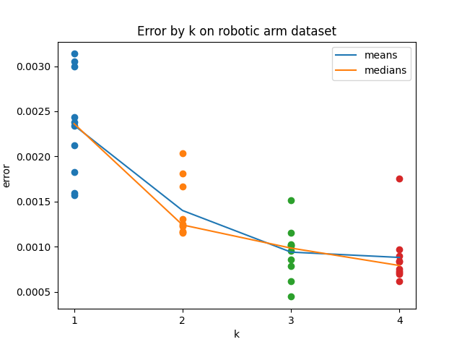
Robot: Multiple values of k (I/II)
10 trials for k = 1, 2, 3, 4 inverse models
Mean error clearly goes down in expected pattern

Slide 4
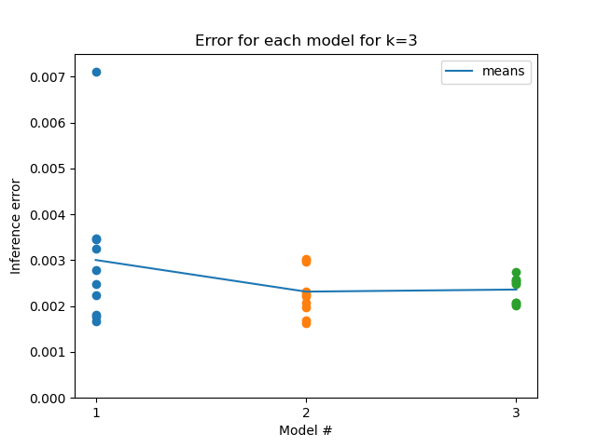
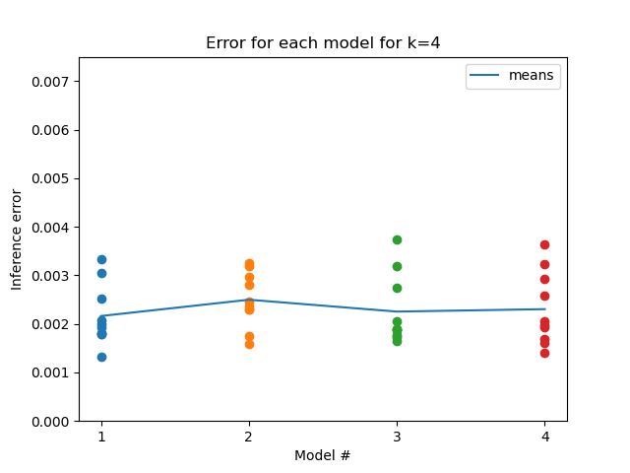
Robot: Multiple values of k (II/II)
Error for individual models is between 0.001 and 0.004 consistently; Ben achieved loss on order of 10^-4, unsure how to improve further (believe I’m using similar hyperparameters)

Slide 5
Robot with repulsion term (I/II)
lambda = 0.02, sigma squared = 0.04
Error ends up being higher than with no repulsion term – doing worse?
Need to investigate if
Bug
Bad hyperparameters

Slide 6
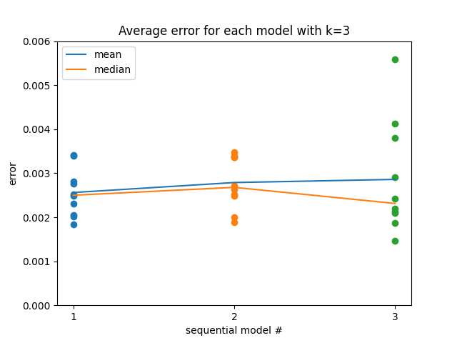
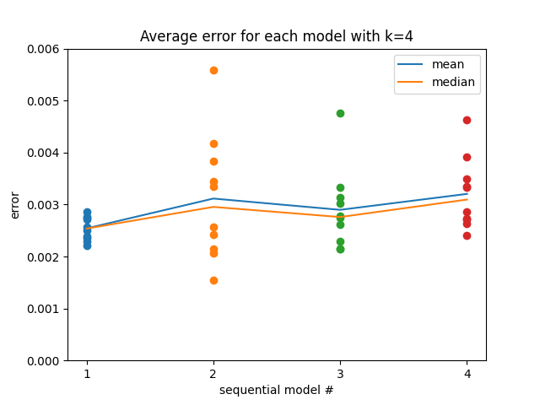
Robot with repulsion term (II/II)
Error clearly increasing for each subsequent model but not sure how significant this increase is

Slide 7
Winter break/next sem. logistics
Winter break
Current meeting time works
Traveling with family from 12/22 to 12/27 – will not have laptop
Next semester
Would like to continue with independent study next semester – if that’s ok, can send forms closer to deadline
Same meeting time would still work

Slide 8
Next steps
New dataset?
Severity of difference in robotic arm performance?
Generate data using forward model to train backwards models
How do I actually do this – random number generation over some x range? If so, what range?
Bigger hypersweep to better see if repulsion term is actually making things worse

